Slide 1
Team 20 Robotics PLC Lab Trainer
Brandon Lim, Kelton McGrath, Gavin Sueltz, Shey Dilloway, Anthony Russo
Dr. Yongzhi Qu
Quinton Christensen

Slide 2
Project Objective(s)
Concisely state the objective(s) of your project in 1 slide
It helps if you include a diagram, image or something like that
You should not spend more than 1 minute on this slides

Slide 3
Scope
Must Be Part of the Scope | Stretch Goals | Task Outside of the Scope
1 PLC trainer platform (control panel, HMI, buttons, switches, indicators, compatible with industry regulations, has examples of sinking and sourcing for input and output devices, analog and digital I/O, serial communication, network communication, wiring diagram) 1 wind tunnel module to teach analog sensing and control (P&ID diagram, wiring diagram, set point control +- 10% errors: volumetric flow rate control TBD & air temperature control TBD) 1 VFD & motor module to teach network and serial communications (P&ID diagram, wiring diagram) 1 Pneumatic switch module to teach digital sensing and control (P&ID diagram, wiring diagram) 1 Cognex camera module to teach network and serial communications (Integration: position/ orientation & color) Documentation/drawings/bill of materials to reproduce product | Advanced Cognex camera integration (defect detection, barcode reading, gliff registration) Interaction/ communication with lab robot arms | Additional modules Senior design lab copy Additional units of the trainer and modules for the class

Slide 4
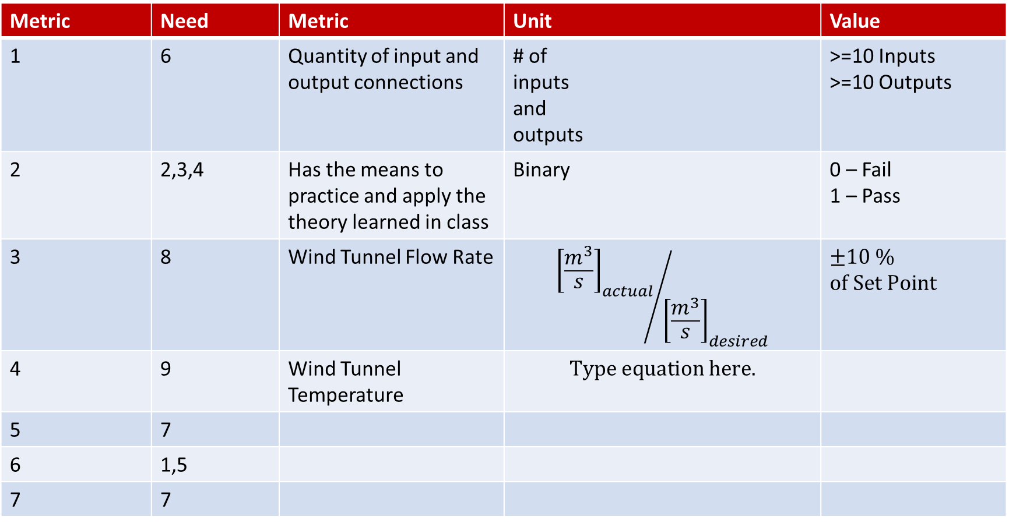
Design Metrics
Metric | Need | Metric | Unit | Value
1 | 6 | Quantity of input and output connections | # of inputs and outputs | >=10 Inputs >=10 Outputs
2 | 2,3,4 | Has the means to practice and apply the theory learned in class | Binary | 0 – Fail 1 – Pass
3 | 8 | Wind Tunnel Flow Rate | $${{\left[\frac{m^{3}}{s}\right]}_{actual}}/{{\left[\frac{m^{3}}{s}\right]}_{desired}}$$ | $±10 \%$ $of Set Point$
4 | 9 | Wind Tunnel Temperature
5 | 7
6 | 1,5
7 | 7

Slide 5
Progress Since Last Design Review
3-4 slides
Discuss recent progress, especially in the context of the Design Process that we are following
Specific quantitative results are best if available
Early on, you may just be getting things started and that’s OK. In those cases, you will discuss your thoughts and ideas and plans going forward more than results and progress.

Slide 6
Technical Issues / Difficulties / Questions
1-2 slides as needed
Any specific technical challenges or questions that you would like to share with the teaching team
Only present this information if needed. If you have nothing to present under this topic, that is fine.

Slide 7
Plans
1-2 slides
Detailed plans for the next 3-4 weeks
Include schedule once it has been developed for the course
Discuss budget and spend once purchasing begins

